Slide 1
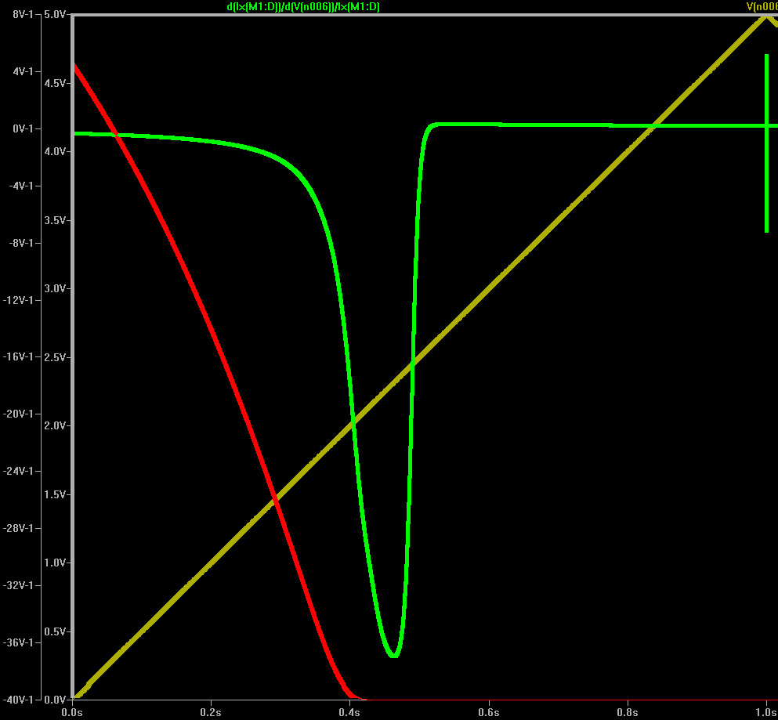
Part 1: Normalization Current
See: “Extraction_MOSFET_parameters.doc to understand formula above
Run: Transistor-Parameter-If-V2.asc
You will see where numbers get to small the green curve drops back to zero. We know maximum of this is
read off the current value at 40/2=20. This is 8x
the normalization current
In this case Is=0.465uA

Slide 2
Part 2: Threshold Voltage Extraction
See: “Unambiguous Extraction of Threshold Voltage.pdf” to understand formula above
Run: “Transistor-Parameter-Vt.asc”

Slide 3
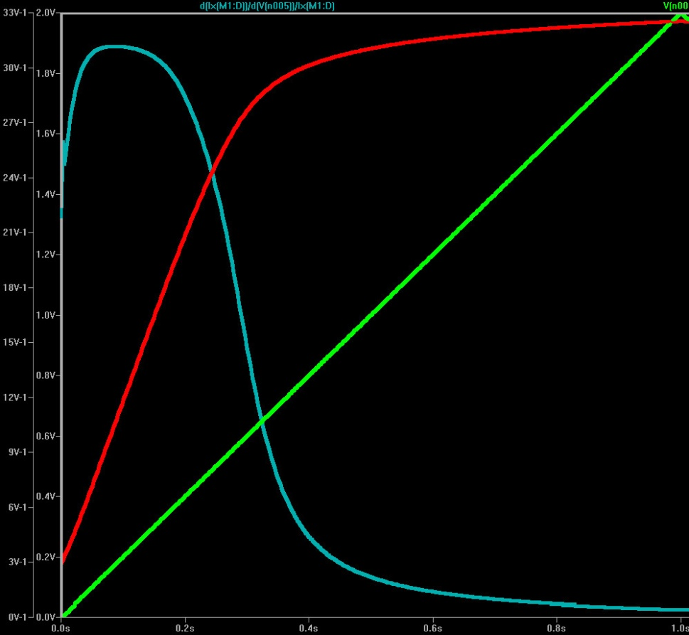
The numeric resolution appears to make the Gmg/Id ratio fall back to zero like near Vgate=0 as in the case of the normalization current determination

Slide 4
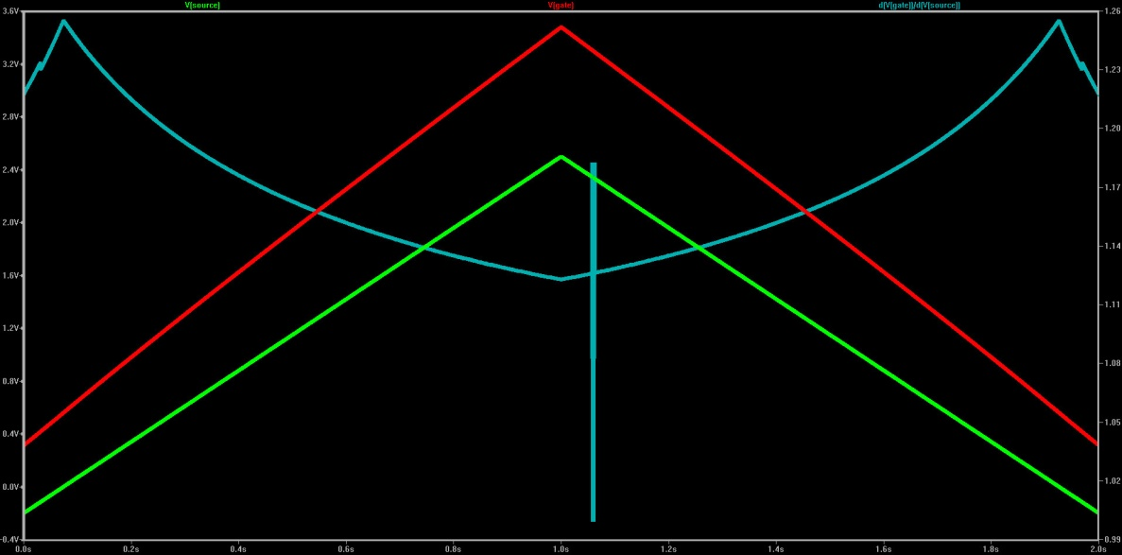
Part 3: Body Factor, Pinchoff Voltage, Threshold Voltage by different method
See: “Extraction_MOSFET_parameters.doc to understand formula above
Run: Transistor-Parameter-Vp.asc

