Slide 1
Part 01: Proposal and Overview

Slide 2
Dual Modulus Prescaler Using Current Mode Logic
Goals
2.5 GHz Operation
8/9 Dual Modulus
0.18uM BSIM 3 Model

Slide 4
D Flip Flop Schematic

Slide 5
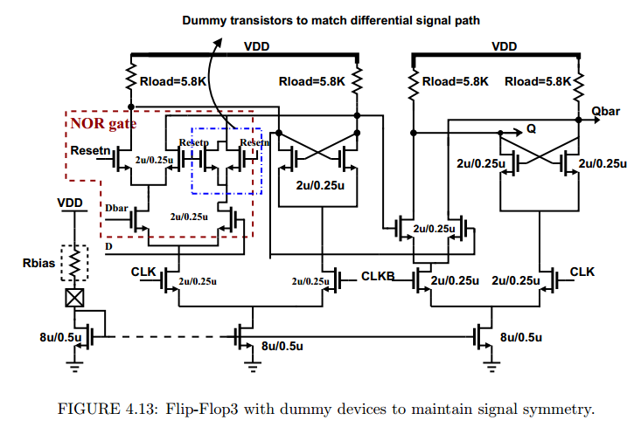
Merged NOR for faster circuits

Slide 6
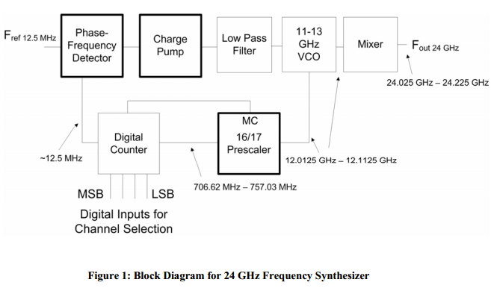
Synthesizer Block Diagram

Slide 7
Part 02: Initial Efforts
LTSPICE with MOSIS 180nM SPICE model

Slide 8
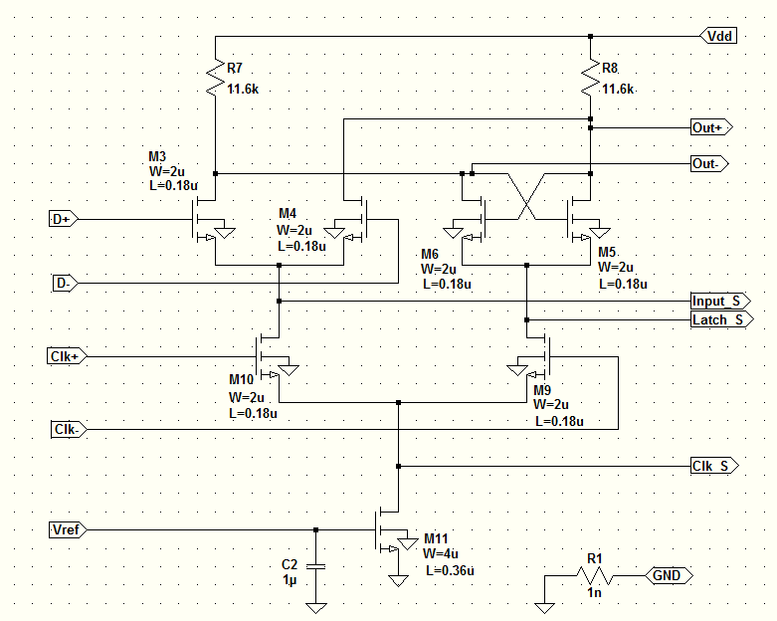
D Latch Schematic

Slide 9
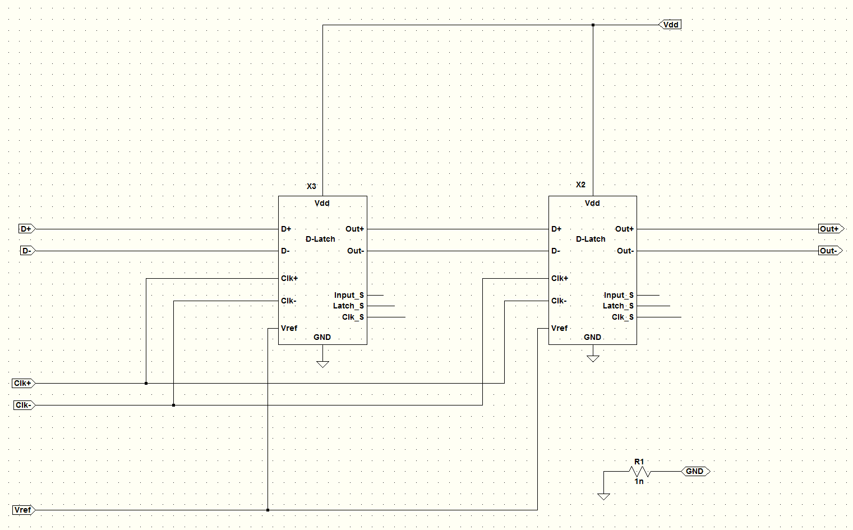
D Flip Flop Schematic

Slide 10
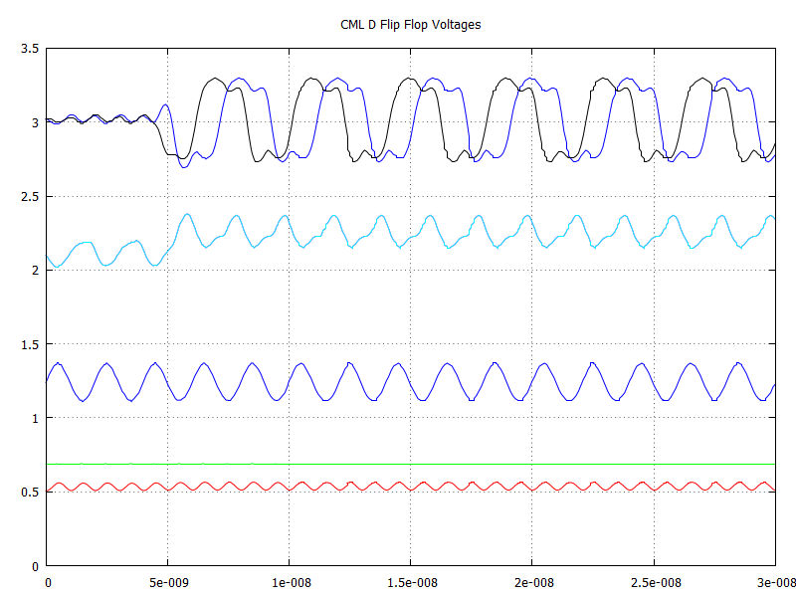
Latch Out
D FET Out
D FET Source
Input 500MHz
Tail Gate V
Tail Drain V

Slide 11
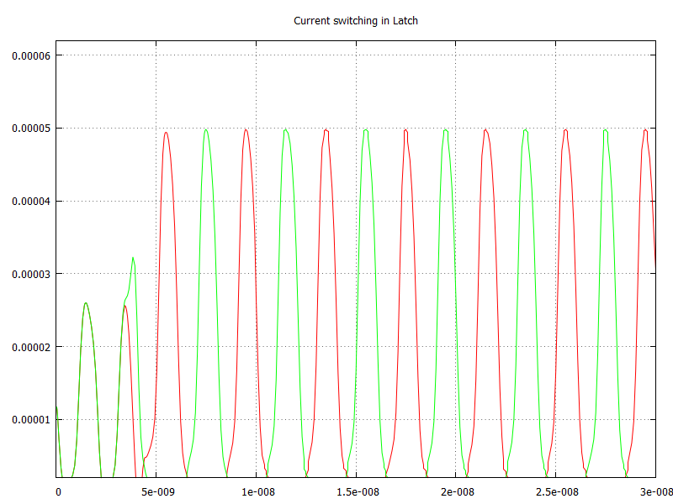
Latch Current Switching
Current from Clk- alternates flow through latch transistors
NOTE: 2 clock cycles required for valid data to show up on D flip flop output divider circuit

Slide 12
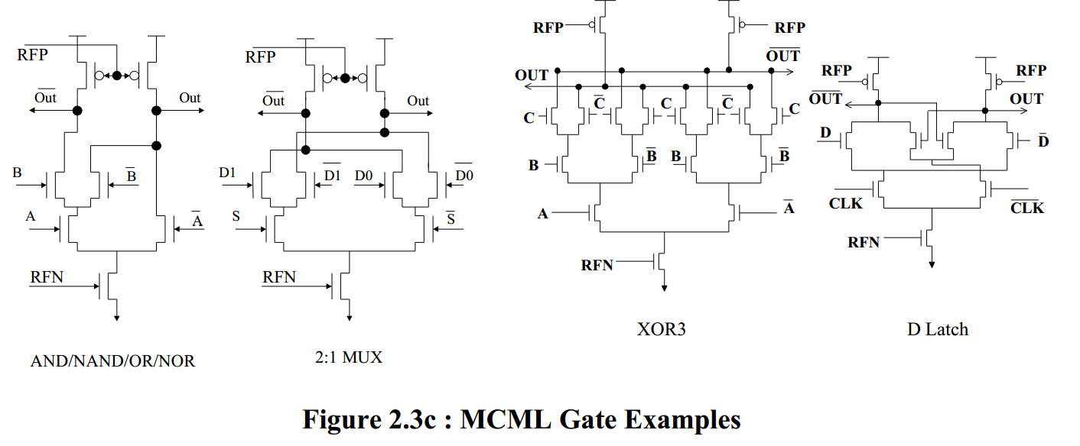
CML Gate Examples

Slide 13
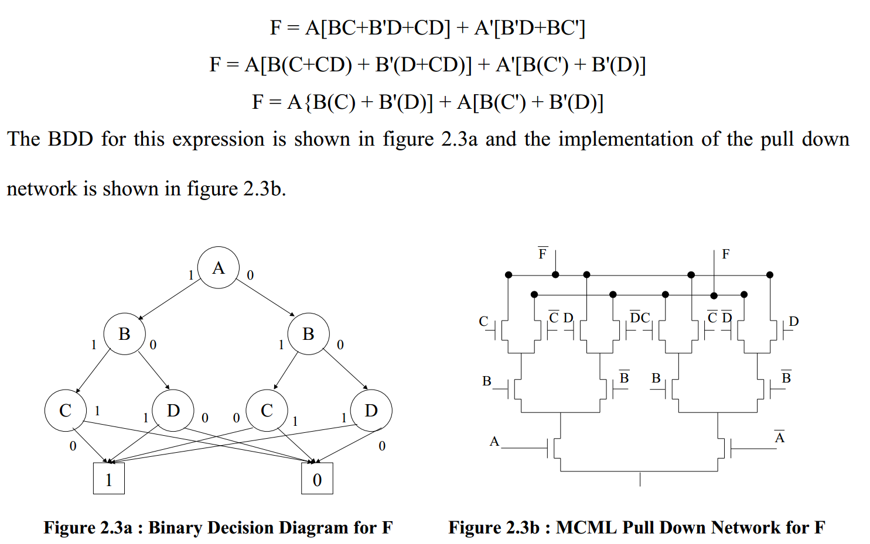
Logic Implementation Example

Slide 14
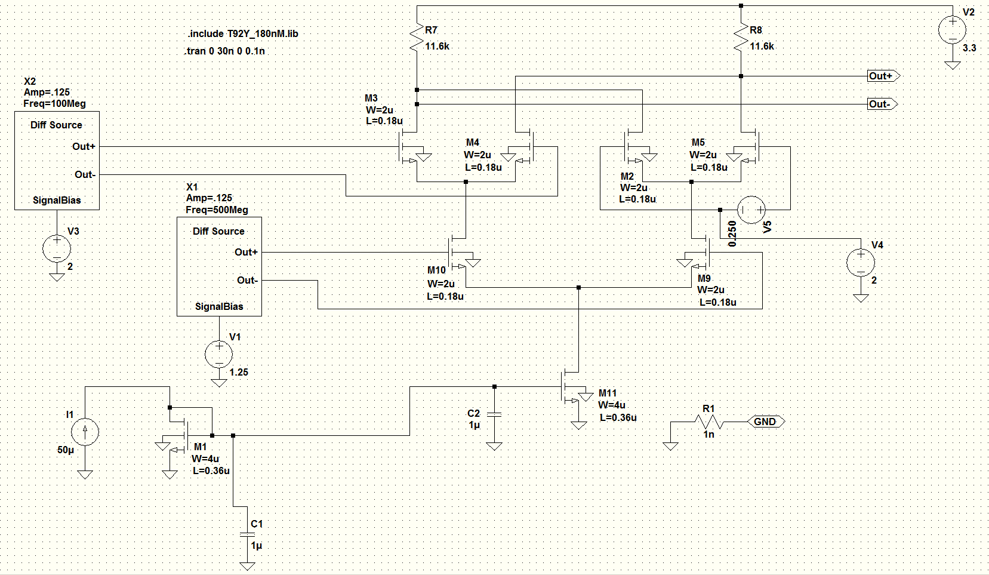
And Nand Or Nor Topology Design

Slide 15
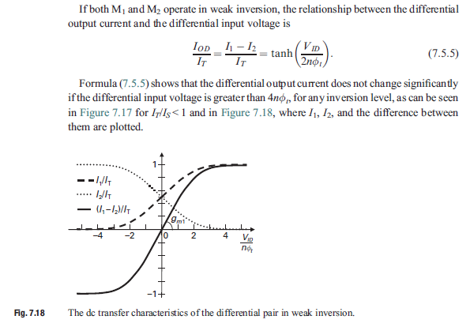
Part03: Analysis of CML Bias / Design / Logic Levels
Differential pair input range

Slide 16
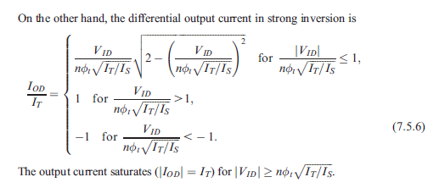
Strong Inversion Diff Pair Input Range
From Page 253 Galup/Schneider

Slide 17
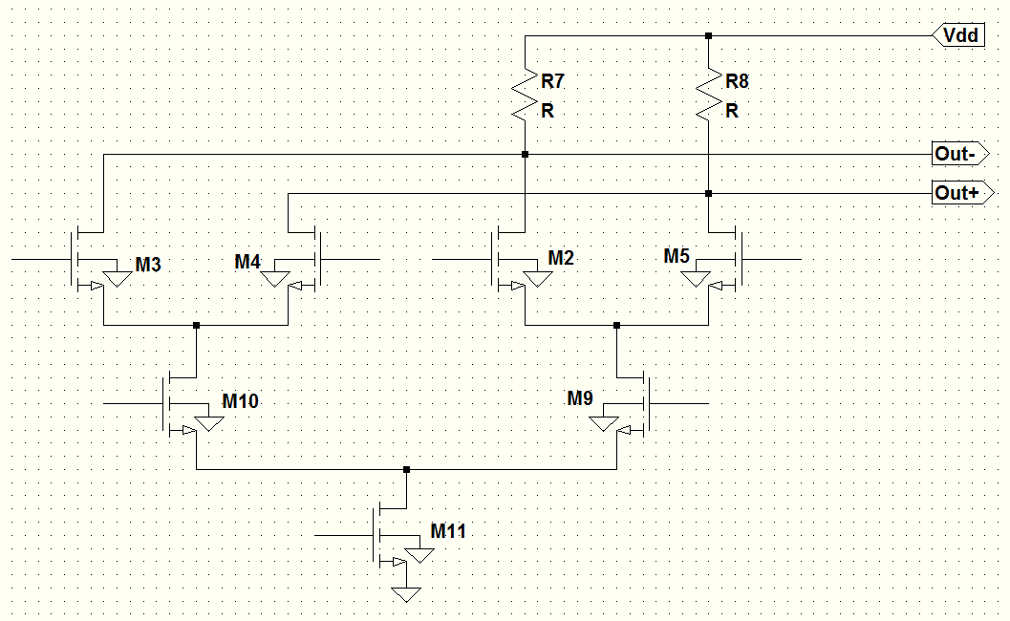
High Diff Pair Common Mode of Output

Slide 18
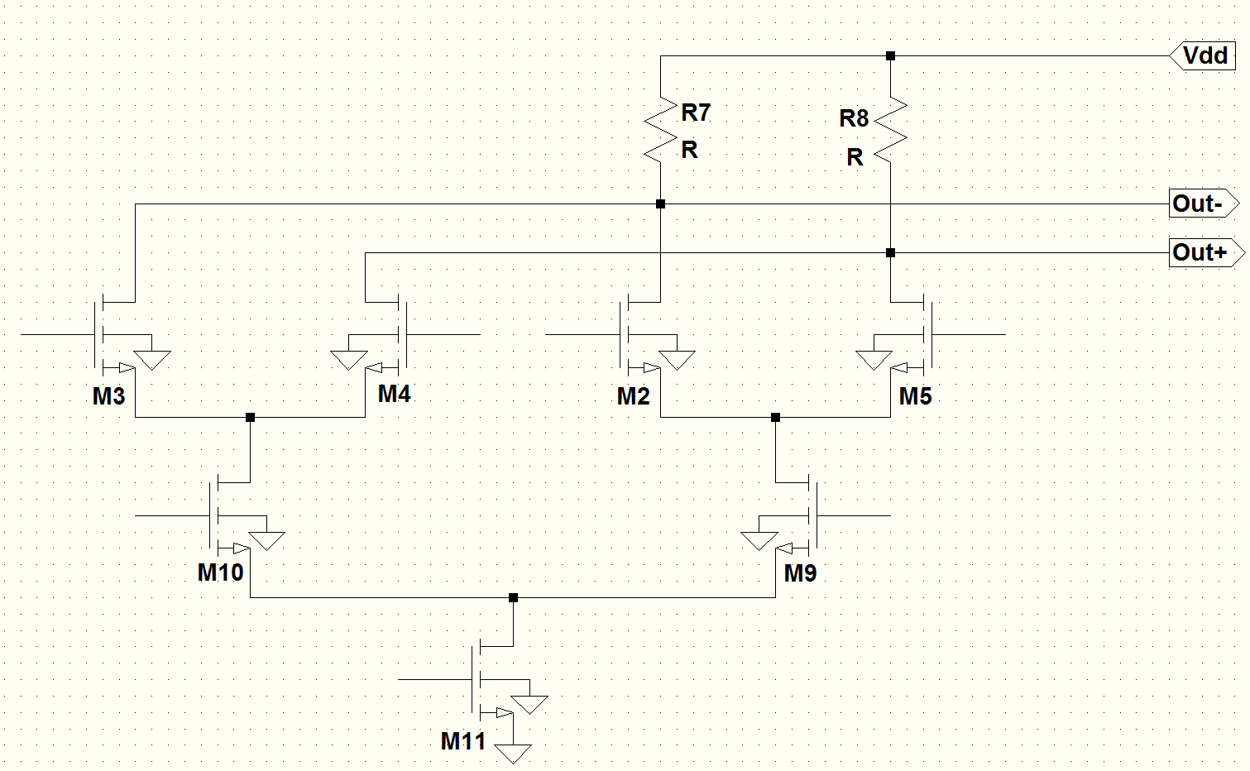
Common Mode Limits
Assume transistors to be in saturation under all conditions
Lower differential pair – Upper limit on common mode

Slide 19
Common Mode Limits
Lower differential pair – Upper limit on common mode

Slide 20
Common Mode Limits: Bottom Pair
Lower differential pair – lower limit on common mode
Putting it all together we can see the common mode of the lower pair can not be the same as the upper pair
Thus when driving the lower differential pair a level shifter is required.

Slide 21
Output Swing Limit
In order to maintain saturation:
See: Ref #1.P35, #3

Slide 22
Part 3A: Hand Design: Things we need
Signal FETs L – Minimum length for maximum speed
Signal FETs W – Simple low frequency analysis using interface criteria
Current Source FET – L, W
Tail Current – Assume a nominal value and optimize performance
Swing
Load Resistance

Slide 23
Hand Design Swing, Signal FET W & L
As previously cover swing should be on the order of Vt
Choose 0.6V
Calculate required width of signal FET using inversion level required to have full current drive + gate over drive
Use gate over drive of 0.300V to insure adequate input drive.
Thus Vid=~0.300V
Since Ispecific of unit width = 1uM is ~2uAmp use W=2uM
(See Appendix 1 for extraction of MOSFET parameters Vt, Ispecific and n the slope factor

Slide 24
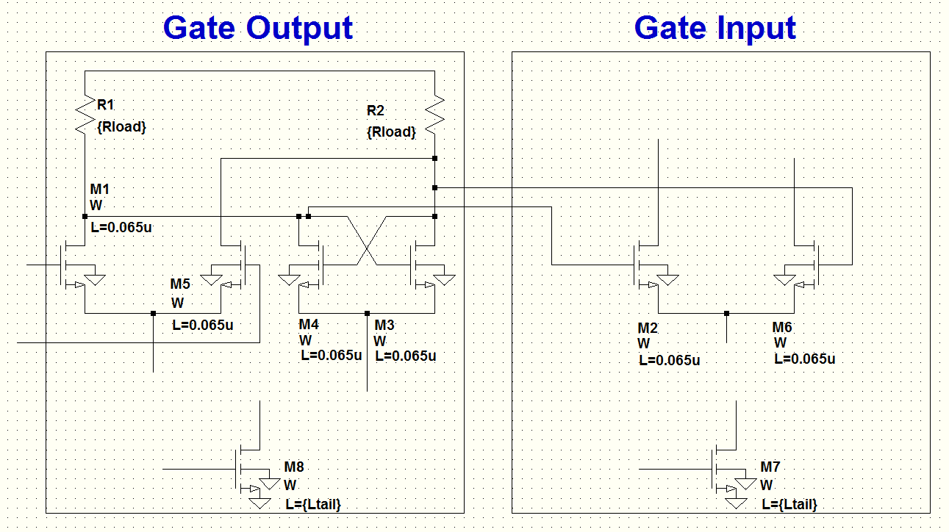
Hand Design: Output == Input
Resistive Loads

Slide 25
Hand Design: Current Source Tail MOSFET
Assume tail Vds = 0.350V well into saturation region
Assume Ltail = 10 x Lmin for the tail impedance to be large compared to signal FET

Slide 26
Hand Design MOSFET Summary
Signal FET Width = 2uM
Signal FET Length=0.065uM ( Minimum )
Tail FET Width = 10uM
Tail FET Length=0.66uM
Increasing Tail FET width & Length will probably more than this will probably run against increasing capacitance and not provide more benefit.

Slide 27
Part 04: Simulation: D Flip Flop in IBM 65nm
MOSIS: IBM-Fishkill 65nm SPICE FILE

Slide 28
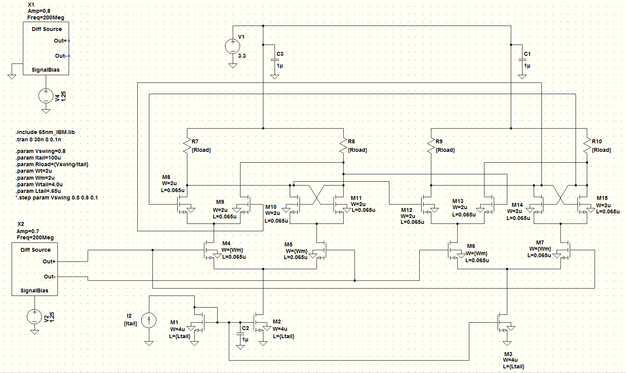
D Flip Flop Optimization

Slide 29
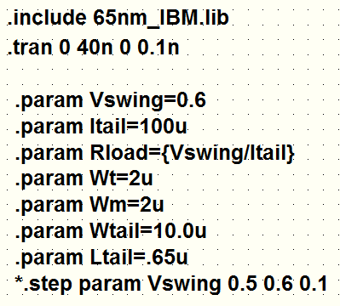
Optimization Parameters

Slide 30
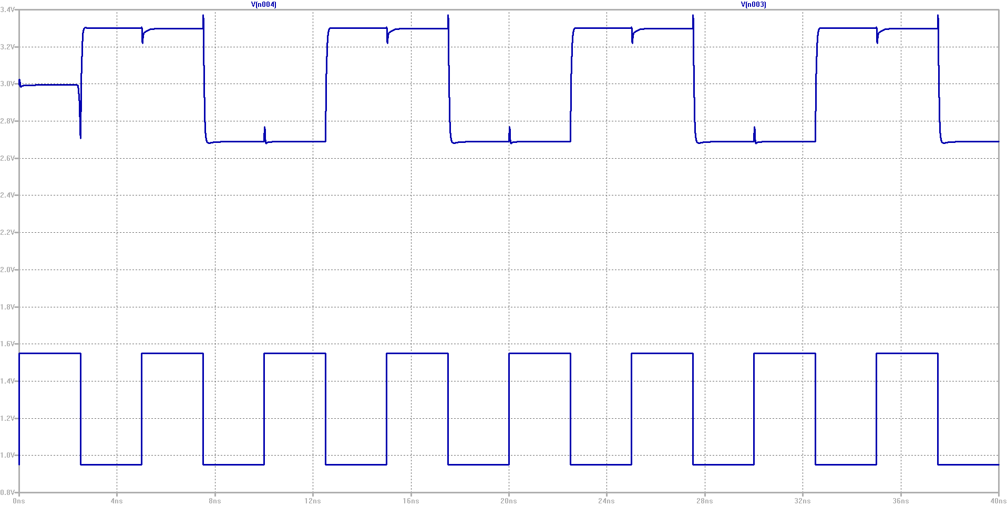
Slow 200MHz Waveforms to see the transients
Minimum time to start divider is 1 rising + 1 falling edge
The glitches are at clock cross over where there is a tail current spike
Vswing=0.6V
Fin=200 MHz

Slide 31
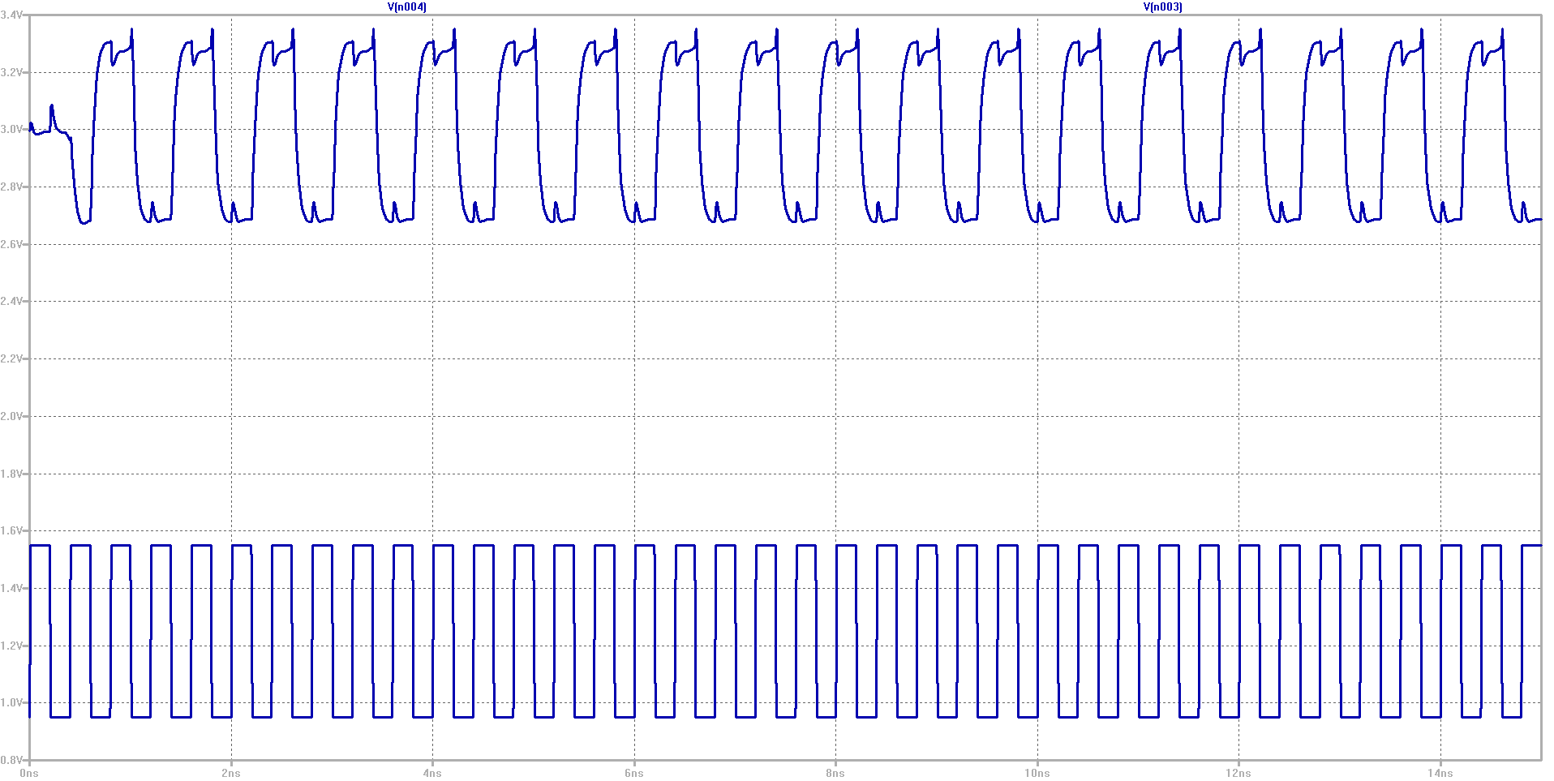
Operation At 2.5 GHz
Vswing=0.8V
Fin=2.5GHz
Divider start up takes more time clock cycles than 200MHz.
Startup does not appear to be affected by swing once above a certain level

Slide 32
D Flip Flop Optimization
Power is independent of frequency
Power is independent of swing
Power consumption = Vdd * Itail * NumTails
Output waveform had better rise time for lower swing
However did not work when used with higher assembly
Changes in signal MOSFET widths resulted in small changes in rise time
Going to Wt = Wm = 1u might be slightly better.
Much narrower or much wider resulted in worse rise times
Works over -40 to +80 C

Slide 33
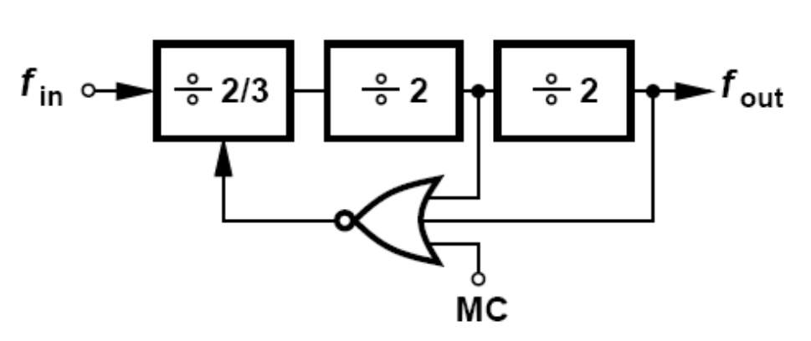
Part 5: Block Build Up
Modulus = 8/9 Prescaler ( See Ref 5 )
2/3 Prescaler
D Flip Flop in /2 configuration
3 input OR gate

Slide 34
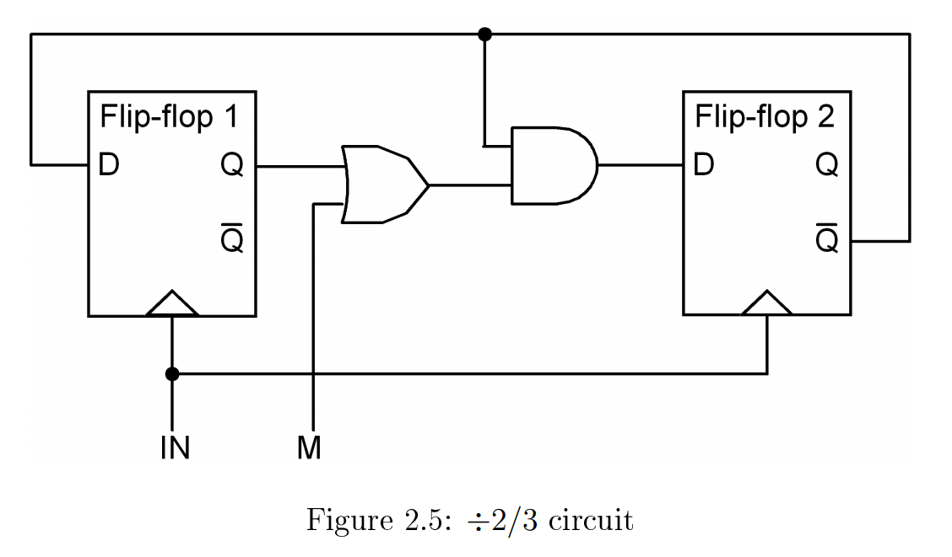
Sub-block: Modulus 2/3 Prescaler
See Ref 6
D Flip Flop in /2 configuration with merged AND gate
2 input OR gate

Slide 35
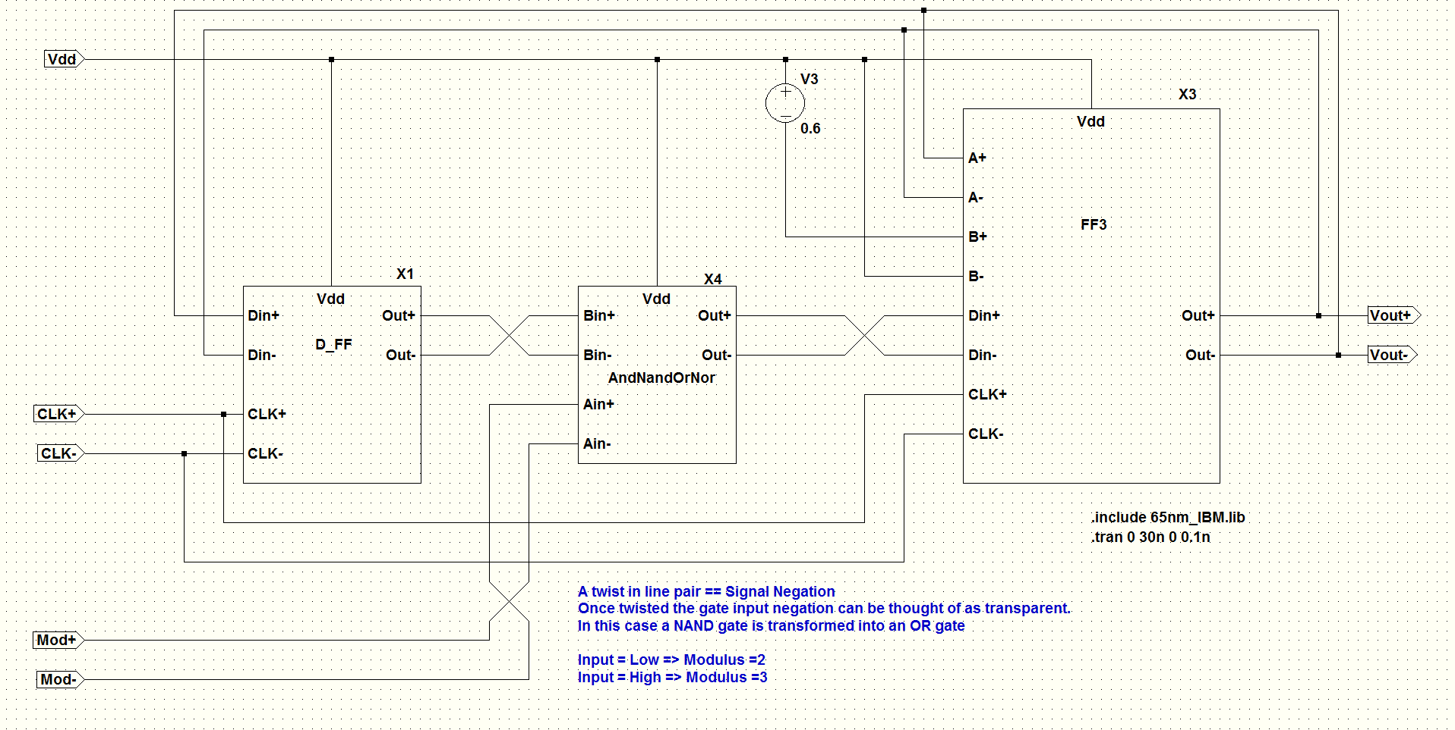
Sub-block: Modulus 2/3 Prescaler – Schematic
AND gate is merged into FF3 sub block
3 input OR gate is not merged

Slide 36
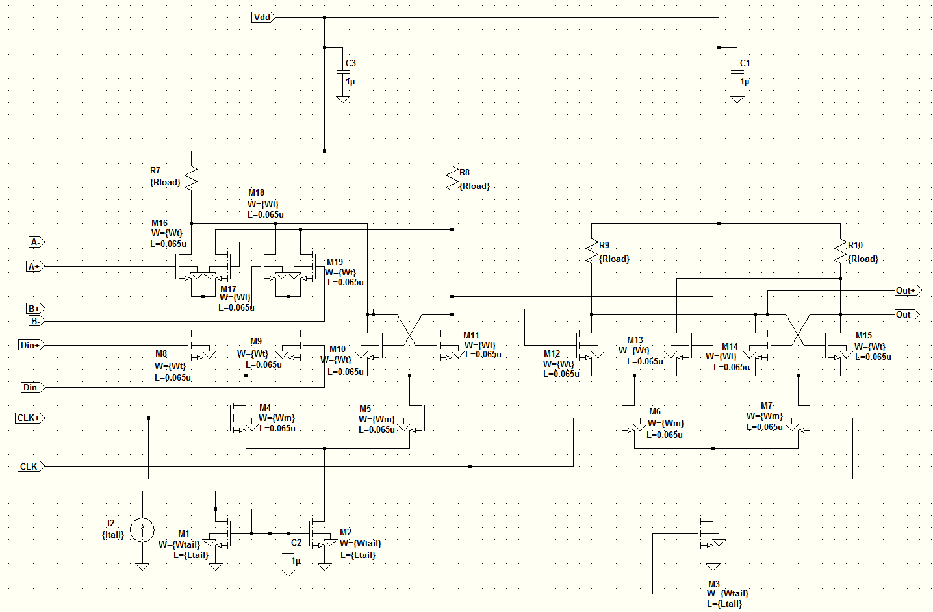
D Flip Flop with Merged AND gate

Slide 37
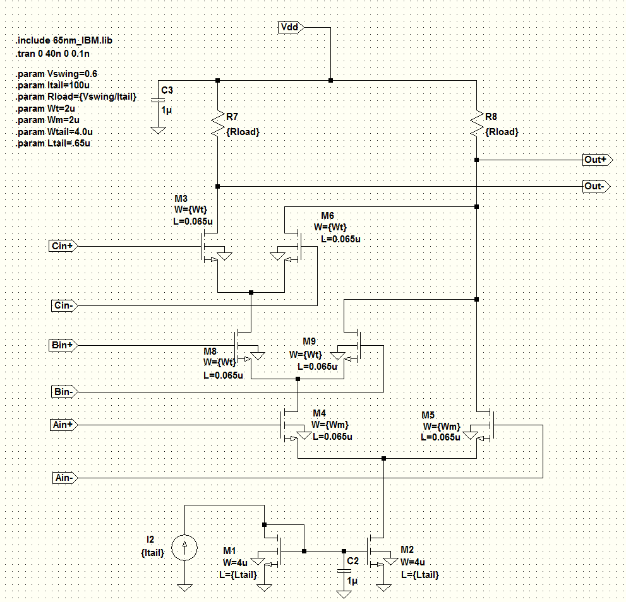
Block : 3 Input OR gate

Slide 38
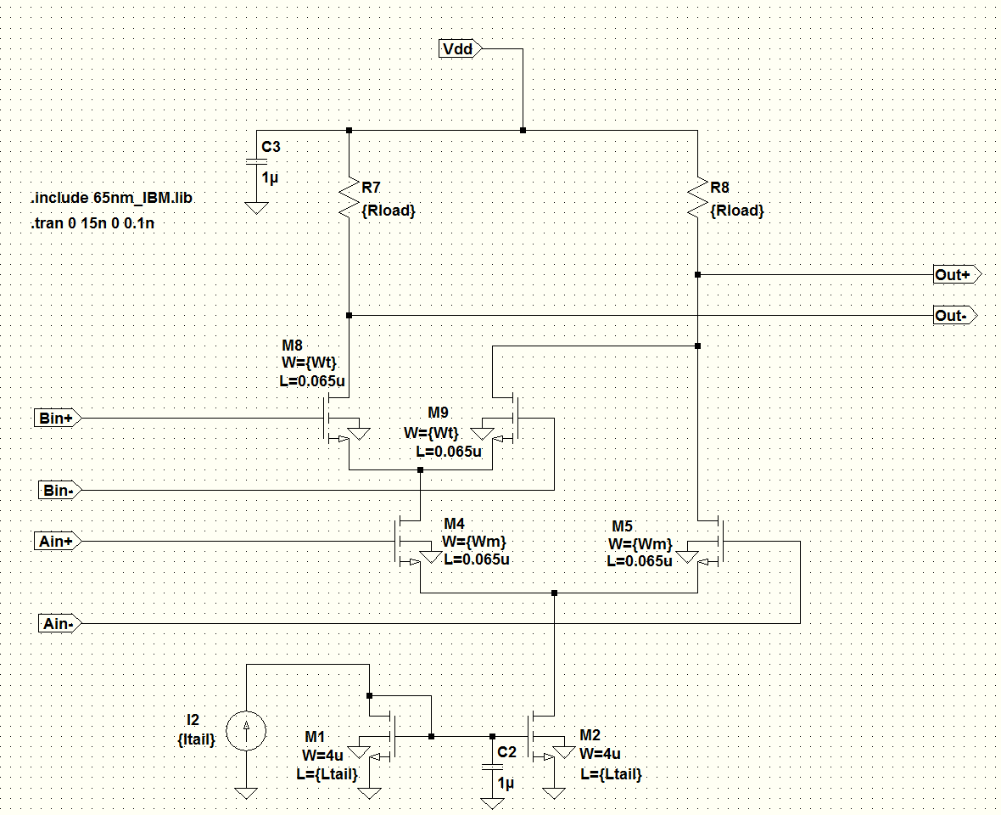
Block : 2 Input OR gate

Slide 39
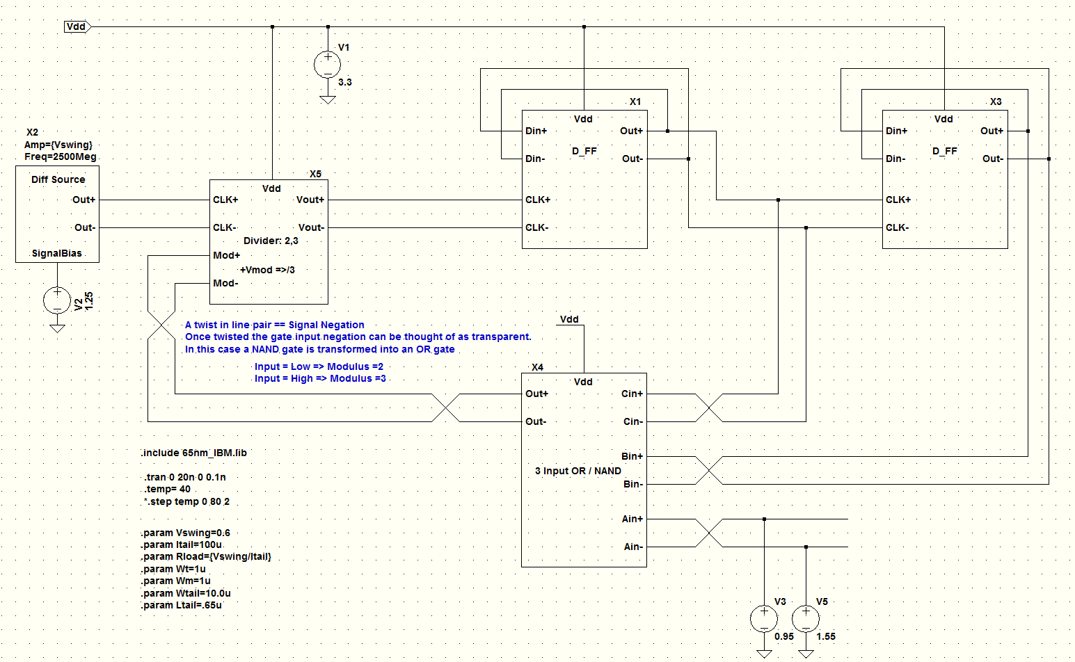
Modulus = 8/9 Prescaler Schematic

Slide 40
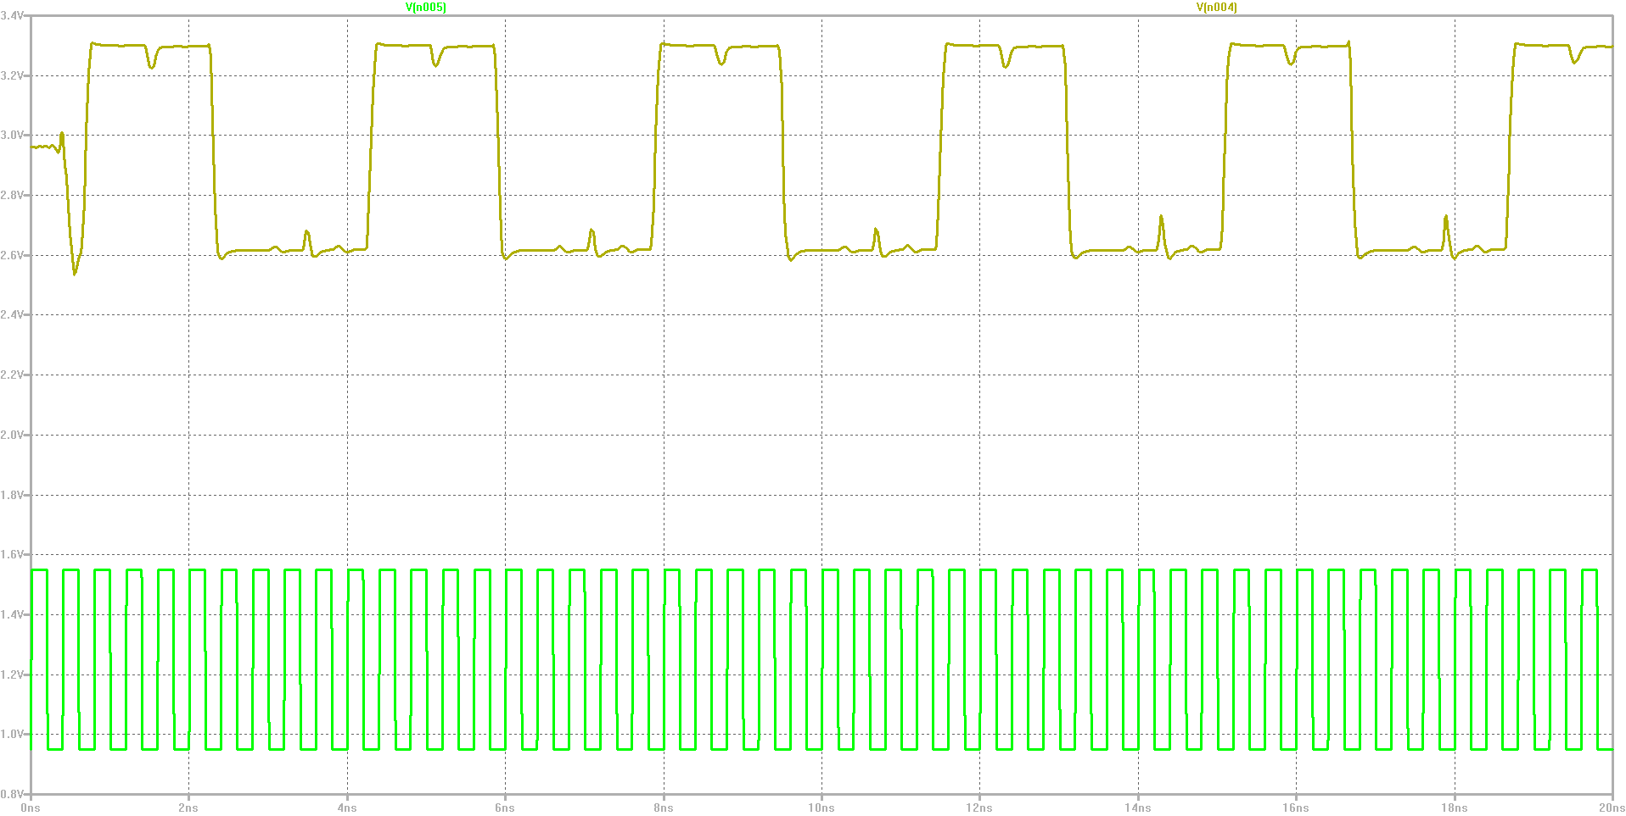
8/9 Prescaler with MOD=9
Input Frequency = 2500MHz

Slide 41
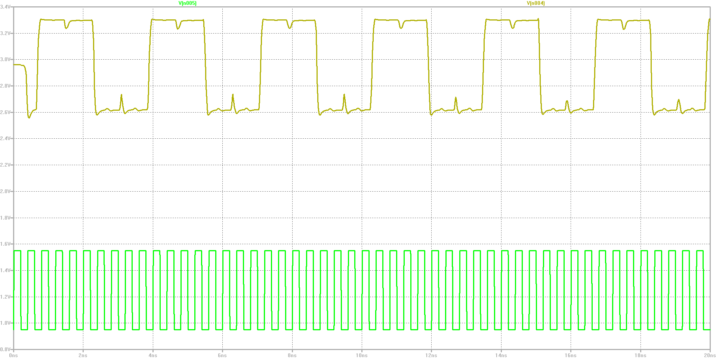
8/9 Prescaler with MOD=8
Input Frequency = 2500MHz

Slide 42
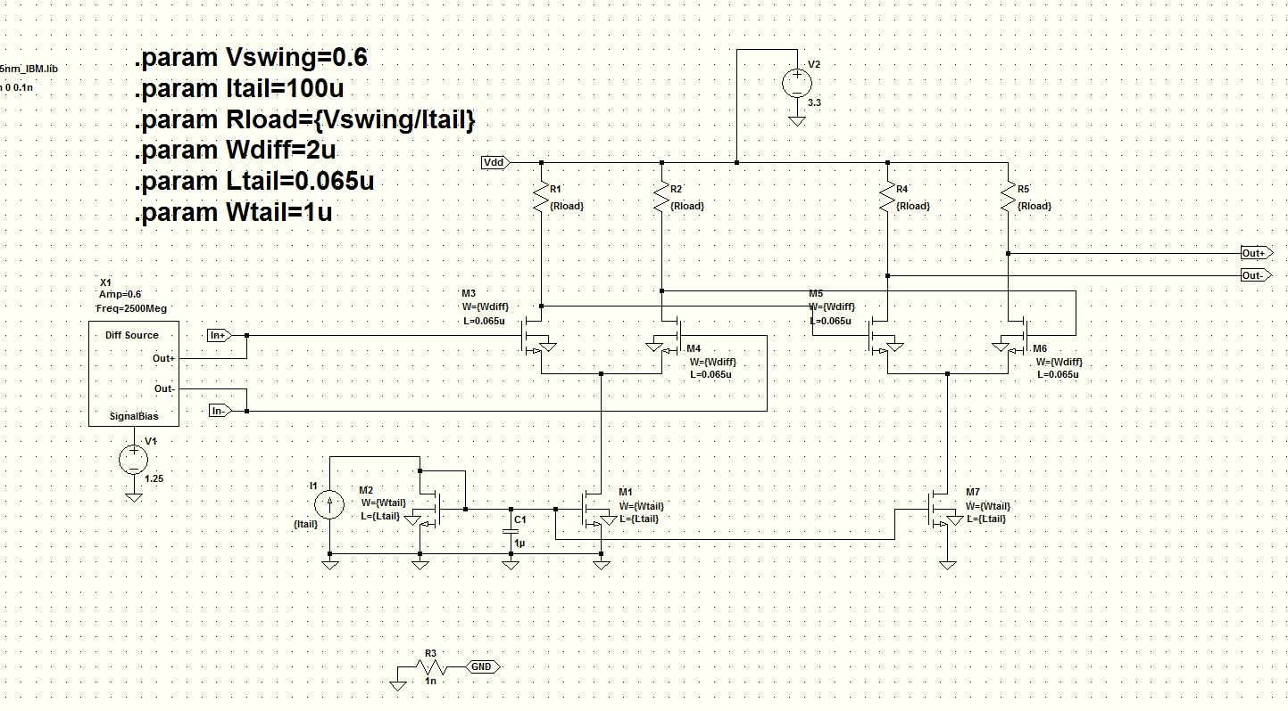
Input Differential Amplifier
Diff Amp with MOSFET differential amplifiers –BiCMOS would be much better according to the papers. To square up the input signal requires too many stages with MOSFETs
Same current tail MOSFET dimensions were tried but did not work well. Simulation suggested a much smaller set of dimensions
You need at least 2 stages to get a nice flat top and bottom. This is because the 3.3 V rail gives good limiting. With signal inversion both top and bottom of signal end up flattened.

Slide 43
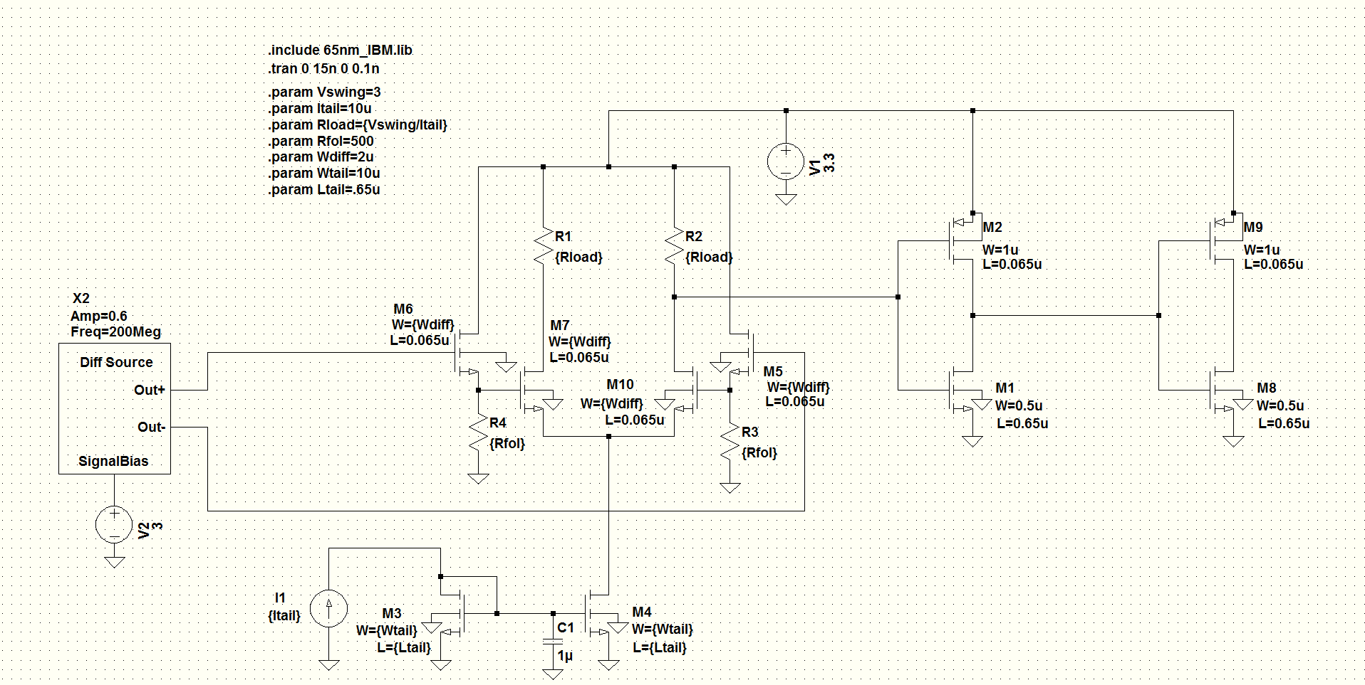
CML to CMOS Converter
Same MOSFET dimensions for differential pair and level shifters – same reasoning.
Requires level shifters on the diff pair input float the source and drain voltages down to accommodate the input of the CMOS inverter
1st Inverter is not fully driven and a second stage is required
Rload=7.5
Itail=400uAmp – higher current required to get the drop without increasing R too much

Slide 44
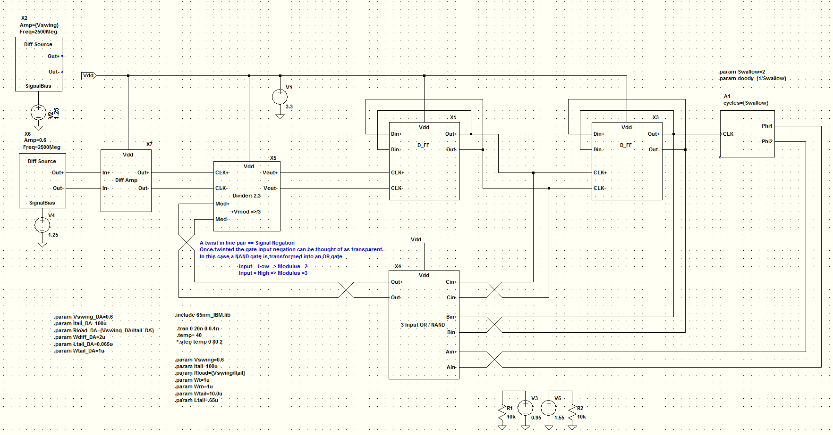
Behavioral Schematic

Slide 45
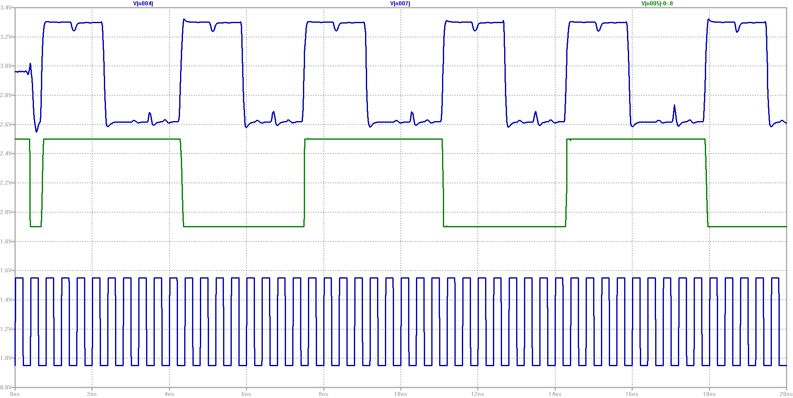
Behavioral Simulation
Traces: Prescaler Out, Modulus Control, Fin=2500MHz
Prescaler feeds /2 counter that controls the modulus input of the prescaler
Division ratio thus alternates between /8 and /9 for each pulse out of the prescaler
Works good at this frequency

Slide 46
Operational Envelope
Frequency Limit: 5GHz @ 25 deg C => dual modulus stops working
4GHz worst case over -40 to +80 deg C
Input signal magnitude: 50mV pp @ 25 deg C
Supply Voltage over -40 to +80 deg C
Minimum=3V
Maximum=3.5V
Power consumption = Vdd * Itail * NumTails = 5mW total
Temperature Range: -40 to 110 deg C with
Vpp-in=0.2V
nom Vdd
Fin=2500MHz

Slide 47
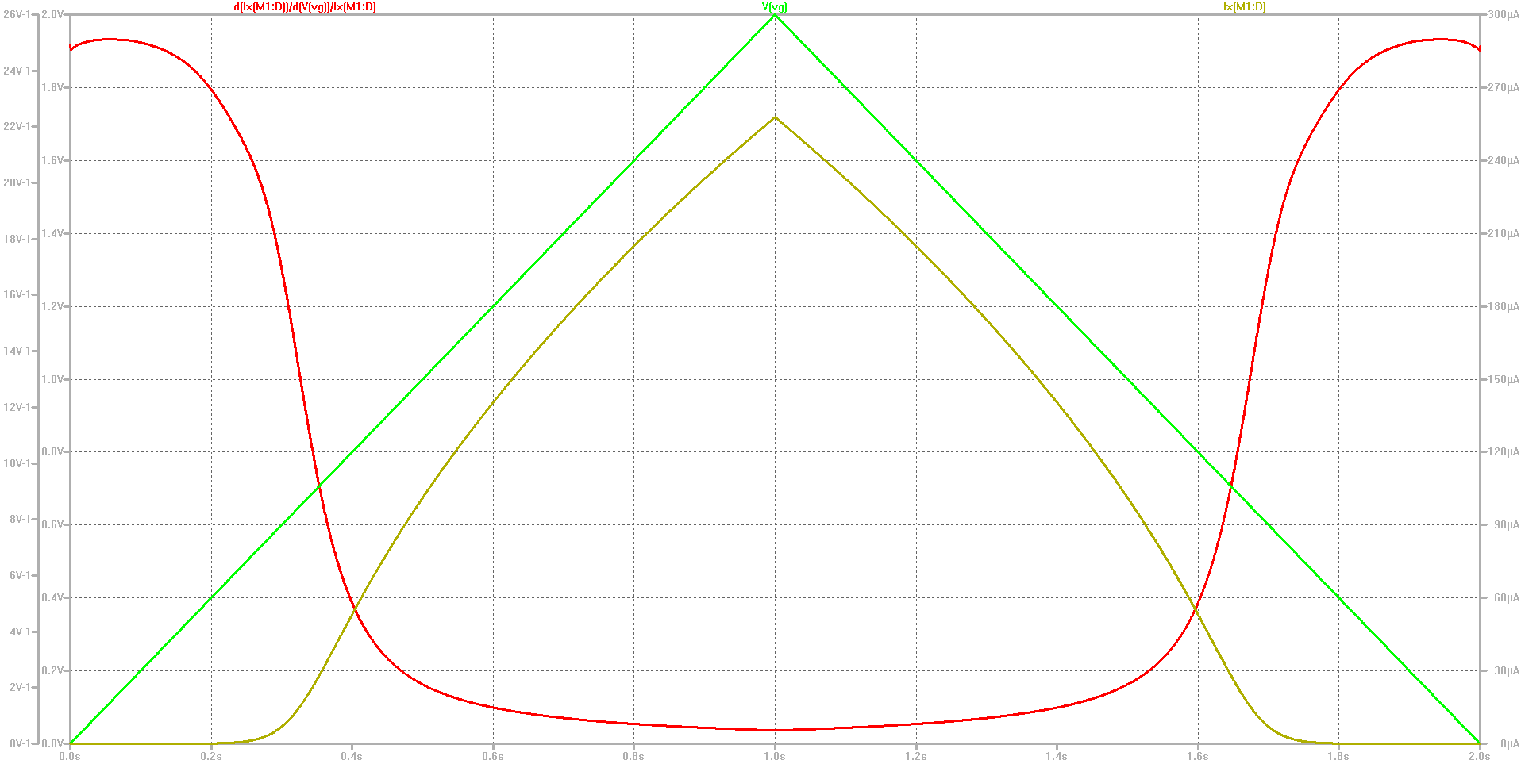
NMOS Specific Current of W=1uM,L=Lmin MOSFET
Appendix 01
Ispecific = 2uAmp Curves are: Vgate, Idrain, gm/Id
Vt=0.650
N=1.6 slope factor

Slide 48
Appendix 02: Early Voltage

Slide 49
Signal FET: W=2uM, L=Lmin
With Vdrain 0.350V or greater Rdrain=~13kOhm

Slide 50
Tail FET: W=10uM, L=10*Lmin
Rdrain=85kOhm @ 0.350 V

Slide 51
References
High-Speed CMOS Dual-Modulus Prescalers for Frequency Synthesis by Ranganathan Desikachari
An Analysis of MOS Current Mode Logic for Low Power and High Performance Digital Logic by Jason Musicer
Video: lecture 6 - Current mode logic - Basic circuit design Nagendra Krishnapura - IIT Madras
CMOS Analog Design Using All Region MOSFET Modeling : Page 253, 254 ( Galup & Schneider ) - Diff pair input range
Frequency Dividers - Professor Jri Lee
Design of a 5.8 GHz Multi-Modulus - Prescaler Vidar Myklebust

